Slide 1
Movie Streaming Platform Database
Presented By: Sreelekha Peram

Slide 2
Project Objective
Design a normalized SQL database for a movie streaming platform
Implement constraints, optimization, automation, and security
Showcase advanced SQL features and real-world data handling.
Subscription-based and pay-per-view streaming.
User profile and watch history tracking.
Real-time content availability and recommendation.
Admin control for content, user, and payment management.

Slide 3
Relational Model Overview
Entities
These are the main objects (tables) in the database that store important data:
Users: People who use the platform (viewers or admins)
Movies: All movie details (title, language, duration, etc.)
Genres: Categories like Action, Drama, Comedy, etc.
Subscriptions: Plans purchased by users (Basic, Premium)
Payments: Records of money paid by users for subscriptions
Ratings: Feedback and scores given by users to movies

Slide 4
Relational Model Overview
Relationships
Many-to-Many between Movies & Genres:
A movie can belong to multiple genres
A genre can have multiple movies
This is managed using a bridge table like MovieGenres(movie_id, genre_id)
Many-to-Many between Users & Roles:
A user can have multiple roles (e.g., viewer, admin)
A role can be assigned to multiple users
Handled using a table like UserRoles(user_id, role_id)

Slide 5
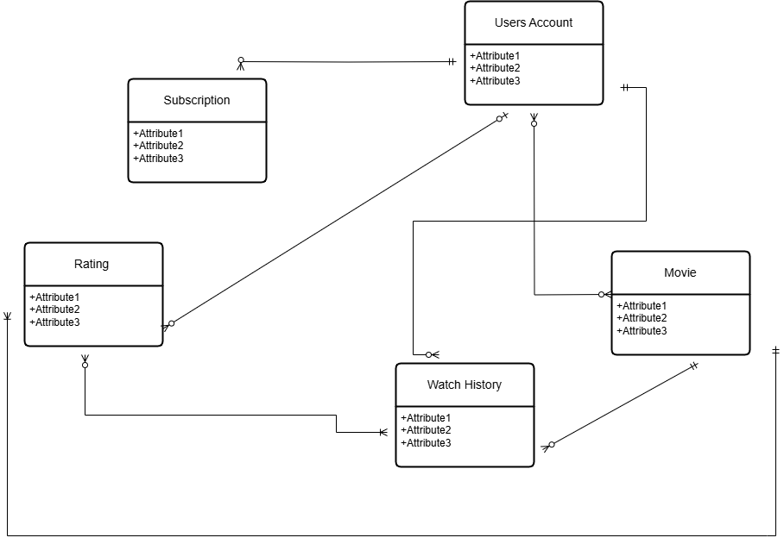
Entity-Relationship Structure

Slide 6
Schema Design Highlights
Normalized to 3NF
Removes data duplication for cleaner design
Ensures each table has a clear purpose
Uses:
PK (Primary Key): Uniquely identifies each record
FK (Foreign Key): Connects related tables
Appropriate Data Types
Chosen for efficiency and scalability
Examples:
INT for IDs
VARCHAR for names/emails
Helps speed up queries and reduce storage
M:N Relationships with Bridge Tables
Handles many-to-many relationships
Bridge tables like:
MovieGenres(movie_id, genre_id)
UserRoles(user_id, role_id)
Makes the schema flexible and easy to expand

Slide 7
Query Functionalities – Summary
Top-Rated Movies Retrieve movies based on highest average user ratings for better recommendations.
User Watch History List all movies watched by a user along with timestamps for tracking activity.
Subscriptions Nearing Expiration Identify users with plans close to expiry to enable timely reminders or renewal offers.
Filter by Genre and Language Allow users to search for movies based on specific genres and preferred languages.

Slide 8
Automation & Security
Stored Procedure – Fetch Watch History Retrieves a list of movies watched by a specific user from the watch history table.
Trigger – Auto Insert Payment Automatically adds a payment record when a new subscription is activated for a user.
DCL – User Access Control Creates database users with specific roles:
Read-Only Access: For viewers or reporting users
Admin Access: For full control including inserts, updates, and deletions

Slide 9
Transaction Management
Used START TRANSACTION, COMMIT, ROLLBACK
Simulated exception handling with duplicate insert
Ensures data integrity during bulk operations.

Slide 10
Key Learnings
Developed complex queries and handled automation
Hands-on experience with real-world SQL scenarios
Gained knowledge in optimization and secure access

Slide 11
Thank You
Ready for Q&A
Submission includes SQL script, ERD, documentation, and presentation

